Slide 1


Engaging the Target:
HD Research Update
Vicki Wheelock MD
Director, HDSA Center of Excellence
at UC Davis
Northern CA HDSA Family Education Day
August 29, 2020

Slide 2
Disclosures
I have received consulting fees from Roche and uniQure
I am serving on the steering committee for the uniQure AMT 130 study
Serve as an investigator for Roche/Genentech Generation HD1 study and Wave Precision HD study

Slide 3
Outline
Background about the acceleration in HD research
Three important current trials
Two important new HD studies

Slide 4

The Challenge in finding treatments for HD
Progressive, hereditary degenerative neuropsychiatric disease
Two FDA-approved therapies for chorea
No disease-modifying therapies exist to delay onset or slow progression
Dr. Nancy Wexler with JoHD patient in Venezuela

Slide 5
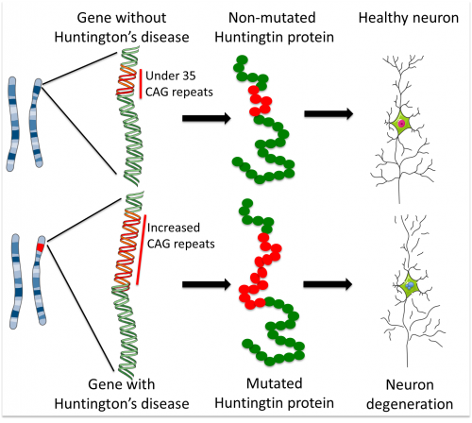
HD is caused by an expansion in the number of CAG repeats in the huntingtin (HTT) gene.
Huntingtin gene (HTT) → huntingtin protein
Wild-type HTT gene
Expanded HTT gene
HD Collaborative Research Group Cell 72:971–983
Notes:
5

Slide 6



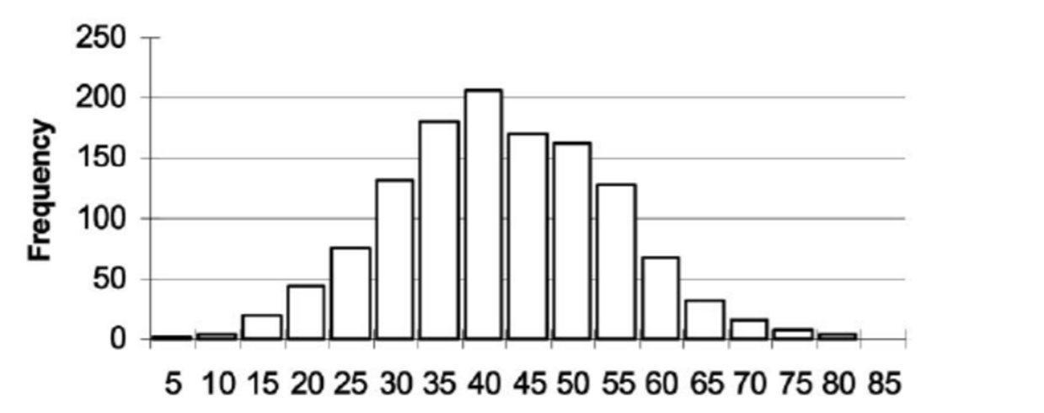
Targeting HD Across the Lifespan

Slide 7
Challenges in research progress
Developing the approach
Delivering the treatment to the brain
Anticipating side effects
Measuring effectiveness

Slide 8
Strengths in research progress
We understand the natural history of HD
Robust involvement of the HD community in HD research
Major research breakthroughs
Multiple sponsors and companies are targeting HD

Slide 9


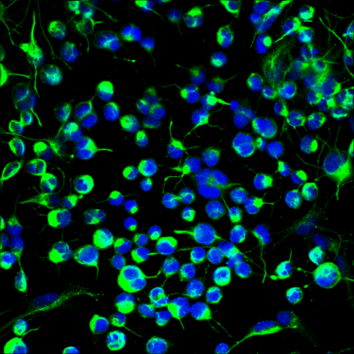


1. Targeting the effects of mutant huntingtin
RNA
Immune System
DNA
Stem Cells
Brain Synapses

Slide 10


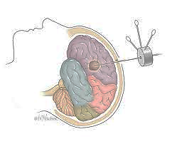
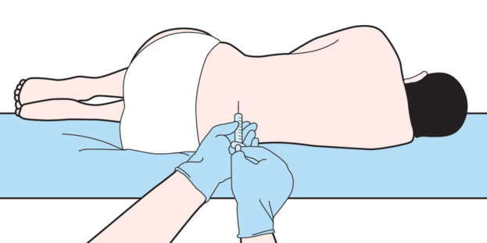
2. Delivering the therapy to the brain
Pill, tablet or capsule
Monthly Intravenous therapy
Lumbar puncture/spinal tap
Intracranial delivery/brain surgery

Slide 11
3. Anticipating side effects
Delivery
Off-target effects
The need for clinical trials
Special considerations: juvenile onset HD

Slide 12
4. Measuring effectiveness
Clinical measures:
Cognition
Behavior and mood
Chorea and motor control
Functional decline
Biomarkers:
mutant huntingtin levels in the spinal fluid
MRI brain scans

Slide 13

Where are we now?

Slide 14

A word about the COVID-19 pandemic and HD research studies

Slide 15

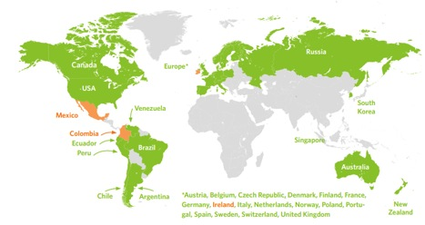
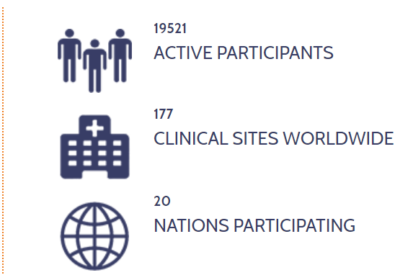
The goal of Enroll-HD is to accelerate the discovery and development of new therapeutics for HD

Slide 16

Huntingtin-lowering therapies

Slide 17
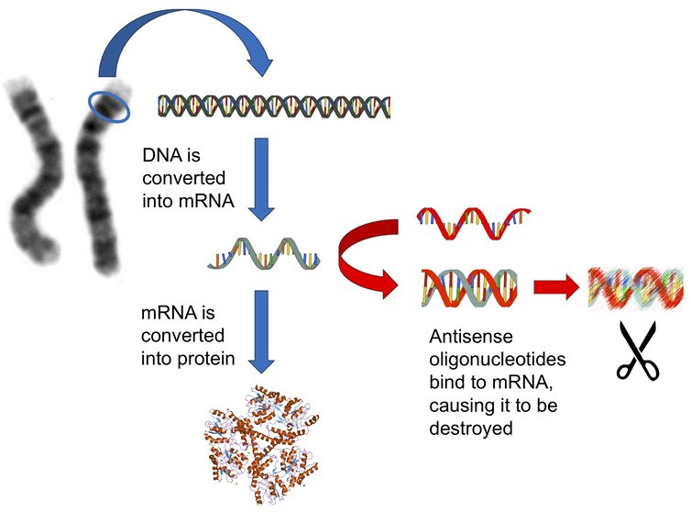
Biggest news in HD research since 1993….
Anti-sense Oligonucleotides (ASO)
This therapy can lower the level of the wild-type and mutant huntingtin protein within the brain
https://medicalxpress.com/news/2017-12-antisense-therapya-neurological-disease.html

Slide 18
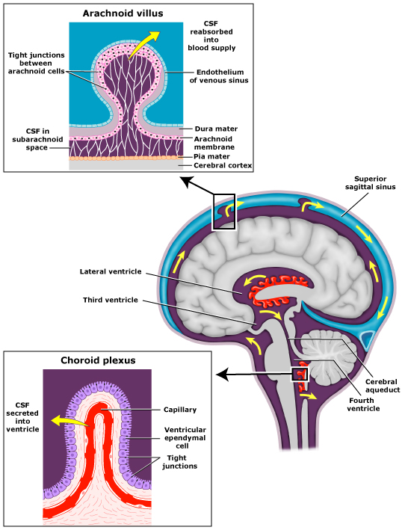
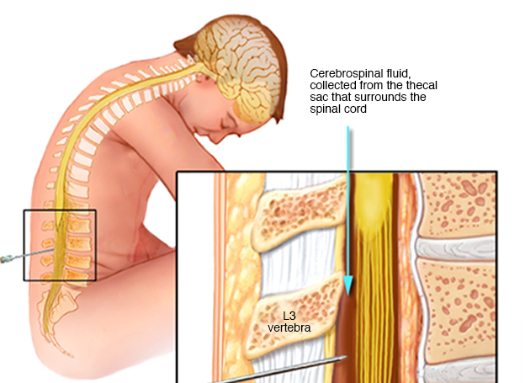

Intra-thecal delivery: spinal tap

Slide 19
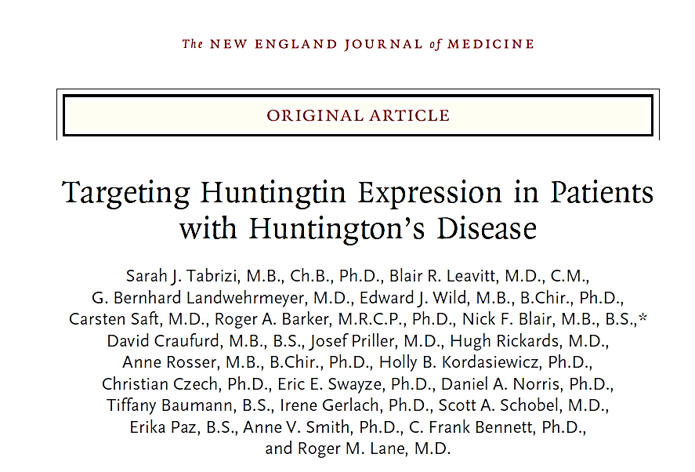
NEJM 380;24 nejm.org; June 13, 2019

Slide 20

Study results
46 patients were enrolled in the trial, with 34 randomly assigned to receive the ASO HTTRx and 12 randomly assigned to receive placebo.
Each patient received four monthly doses via spinal tap and completed the trial.
No serious adverse events were seen in HTTRx-treated patients. There were no significant adverse changes in laboratory tests.
Treatment resulted in a dose-dependent reduction in the concentration of mutant huntingtin in cerebrospinal fluid.

Slide 21
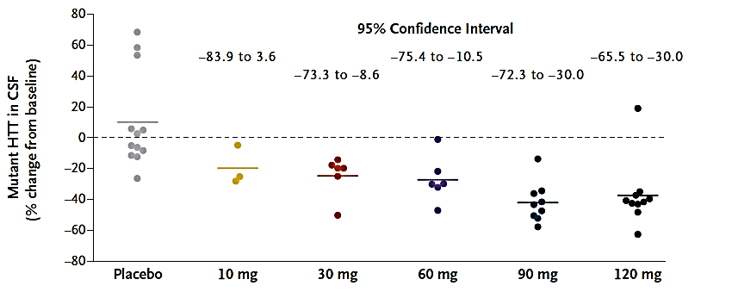
Reduction in CSF mutant huntingtin protein levels
These findings led to Roche Pharmaceuticals/Genentech in US to launch an historic Phase 3 clinical trial of this therapy in HD

Slide 22
Generation HD1 Study
Phase 3 trial to evaluate to the effectiveness and safety of tominersen treatment given every 2 - 4 months over a period of 25 months
This global study has enrolled 800 patients with manifest HD at 80-90 sites in approximately 15 countries around the world.
Participants are randomized to one of three treatment study arms:
  tominersen every 2 months
  placebo every 2 months
  tominersen every 4 months
Clinicaltrials.gov NCT03761849

Slide 23
Generation HD1 Study
Eligibility:
  Age 25 – 65 years
  Diagnosed with Huntington’s disease
  Still relatively independent
  Genetically confirmed disease by direct DNA testing
  Clinical assessment to ensure individual has intact functional independence at baseline to maintain self-care and core activities of daily living (ADLs).
Clinicaltrials.gov NCT03761849

Slide 24
Generation HD1 Study
Exclusion Criteria:
  Any serious medical condition or clinically significant laboratory, or vital sign abnormality at screening that, in the investigator's judgment, precludes the patient's safe participation in and completion of the study
  Pregnant or breastfeeding, or intending to become pregnant during the study or within 5 months after the final dose of study drug
  Must be able to tolerate 16 in-person visits, 14 lumbar punctures, 5 MRI brain scans, use wearable digital devices daily for 2.5 years
Clinicaltrials.gov NCT03761849

Slide 25
Generation HD1 Study
Primary Outcome Measures, change from baseline in:
  Composite Unified Huntington's Disease Rating Scale
  Functional Ability Score
Secondary Outcome Measures, change from baseline in:
  Motor and cognitive function
  Clinical Global Impression Scale
  Biomarkers: plasma and CSF concentrations of drug
  Presence of anti-drug antibodies
  CSF mutant huntingtin protein levels
Clinicaltrials.gov NCT03761849

Slide 26

Another approach: Allele-specific ASO
Healthy HTT
Expanded HTT
In most HD patients, there are tiny genetic differences called SNPs in the huntingtin gene outside of the CAG repeat expansion region that can allow scientists to target ONLY the expanded huntingtin mRNA, leaving the healthy “wild-type” huntingtin mRNA unaffected.

Slide 27
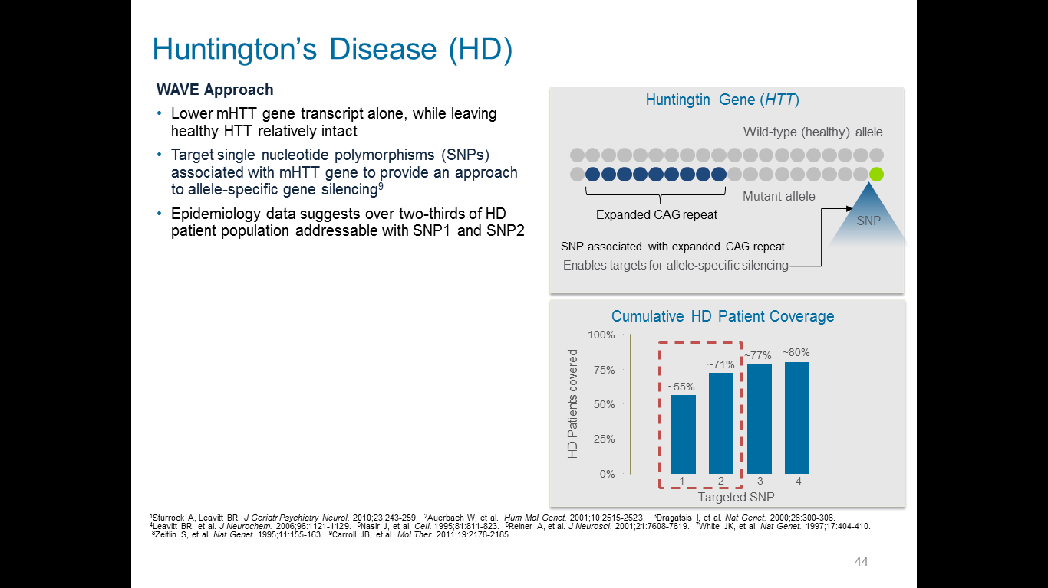
Taking advantage of SNPs:
Allele-specific ASO
Courtesy Dr. Michael Panzara, WAVE Life Sciences

Slide 28
HD SNP1 and SNP2 are found in about 2/3^{rds} of HD patients
Courtesy Dr. Michael Panzara, WAVE Life Sciences

Slide 29

PRECISION HD Trials
WVE-HDSNP2-001
First-in-human Phase 1a/2b trials initiated in 2017 in Canada and Europe and in US in 2018
A Multicenter, Randomized, Double-blind, Placebo-controlled, Phase 1b/2a Study of WVE-120102 Administered Intrathecally in Patients With Huntington's Disease
Primary objective: Assess safety and tolerability of intrathecal doses in early manifest HD patients
Patient SNP determination (SNP-1, SNP-2, other) at pre-screening visit
Approximately 60 patients per trial

Slide 30
PRECISION HD Trials
WVE-HDSNP2-001
Key inclusion criteria:
  Age ≥25 to ≤65, Stage I -II Huntington’s disease
  Presence of HD SNP2
Key exclusion criteria:
  Absence SNP 2; advanced stage HD, coagulopathy, unstable medical or psychiatric features of HD
Primary outcome measure: Number of patients with adverse events (AEs)
Secondary outcome measures: pharmacokinetics of WVE120102 in plasma, mHTT in CSF, total functional capacity, MRI
December 30, 2019: WAVE announced 12.5% lowering of mutant HTT

Slide 31

AAV5-miHTT = AMT-130
The study medication is an artificial micro-RNA specifically tailored to reduce huntingtin messenger RNA.
This drug, AMT-130, is packaged with Adeno-Associated Virus (AAV)Type 5, designed to enter brain cells and direct them to permanently produce the micro-RNA that reduces the production of both wild-type and toxic HD protein.
Administered directly to the brain target via single neurosurgery procedure.
The therapy will be permanent, and the effect is predicted to be long-lasting
http://uniqure.com/gene-therapy/huntingtons-disease.php

Slide 32


AAV5-miHTT = AMT-130
Animal studies:
Transgenic HD mouse model studies showed improvements
Transgenic HD minipig studies showed improvements in brain pathology, with dose-dependent and sustained reduction of mutant huntingtin protein (mHTT) in the deep structures of the brain – including the striatum and the putamen and the cortex

Slide 33
AMT-130 Study
Title: Safety and Proof-of-Concept Study With AMT-130 in Adults With Early Manifest Huntington Disease
First-in-human study
Single neurosurgical administration of AMT-130
  Cohort 1: Low-dose vs placebo
  Cohort 2: High dose vs placebo
  Control group: “imitation surgery” for both cohorts
Blinded study: the patient, care partner, investigator and outcomes assessor will not know the treatment assignment for the
Duration of study: 18 months blinded Core Study period, 5 years follow-up in total
Primary outcome measure: Safety and tolerability
Other assessments: clinical rating scale of HD signs and symptoms, brain MRI scan, lumbar puncture for measurement of mutant huntingtin protein levels
ClinicalTrials.gov Identifier: NCT04120493

Slide 34

AMT-130 Study
Number of patients in study = 26
Eligibility:
  Men and women, ages 25 – 65
  Early-stage manifest HD
  CAG repeats 44 or higher
  MRI brain scan shows adequate size of brain target for implantation
  Stable medical status and medications for HD
  No medical contraindications to MRI, lumbar puncture, brain surgery
ClinicalTrials.gov Identifier: NCT04120493

Slide 35
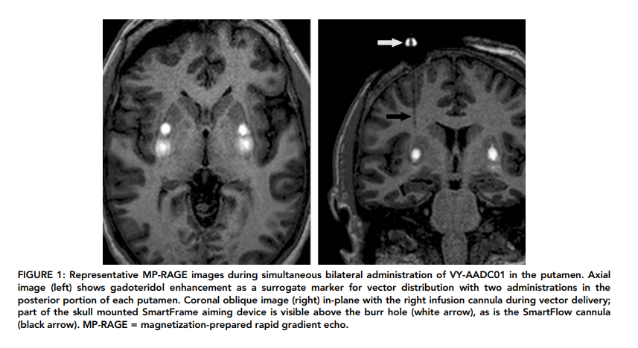
Delivery of AMT-130:
Neurosurgical delivery with Interventional MRI

Slide 36
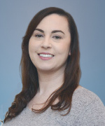
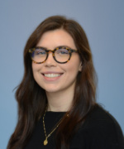
Currently enrolling HD clinical trials and observational studies
uniQure AMT-130 study
Kinect-HD Study
ChANGE-HD study
UCSF
UC Davis
Talia Hamm
UC Davis
Becky Craig

Slide 37


What is the KINECT-HD Study?
A double blind, randomized, placebo- controlled clinical trial.
A research study (clinical trial) studying:
  The effectiveness of valbenazine to reduce chorea associated with Huntington’s disease
(HD).
  The safety and tolerability of valbenazine in individuals with HD.

Slide 38
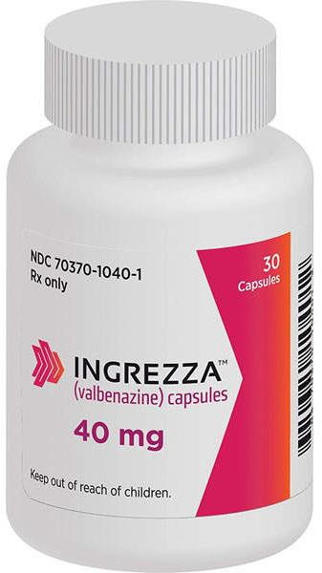
What is valbenazine?
Approved by the United States Food and Drug
Administration (FDA) in April 2017 for the treatment of adults with tardive dyskinesia, under the trade name INGREZZA®.
A prescription medicine used to treat adults with movements in the face, tongue, or other body parts that cannot be controlled (tardive dyskinesia).
Thought to work directly in the region of the brain that causes uncontrollable movements in tardive dyskinesia.
Being studied for the treatment of chorea associated with HD. The commercial use of valbenazine to treat chorea associated with HD is not approved by Health Canada or the U.S. Food and Drug Administration (FDA).

Slide 39



What are the most common side effects from valbenazine?
  Drowsiness
  Tiredness
  Sedation (feeling calm, relaxed or sleepy)

Slide 40

Who can participate?
KINECT-HD will enroll approximately 120 participants who must meet several criteria, including:
  Male or female, ages 18-75 years
  Diagnosis of motor manifest Huntington’s disease
  Have bothersome or troublesome chorea (that meets the study protocol requirements)
  Willing and able to comply with study instructions and procedures

Slide 41
How long is the study?
Participation in this study consists of 9 total study visits that will last up to 18 weeks. Visits include:
Up to 4 weeks of screening
12 weeks of study drug dosing
A final study visit 2 weeks after the last dose of the study drug (valbenazine or placebo).

Slide 42


How is the study drug administered?
The study drug will be provided at your study site.
Participants will take the study drug at home, or on their own (in the presence of a caregiver, if applicable) once daily.

Slide 43

At the conclusion of the trial, the study team will analyze the data and determine if valbenazine is safe, well tolerated and effective in treating chorea in individuals with HD.

Slide 44
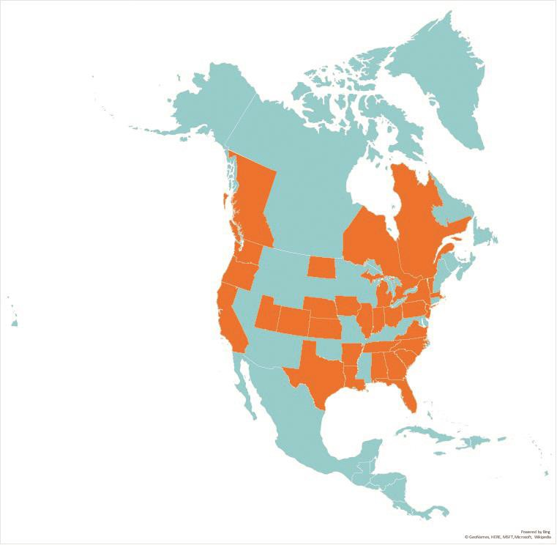
Where is this study taking place and how do I find a study site?
Kinect-HD is being conducted at 55 sites in north America
Visit:
  http://www.KINECT-HD.org/
  http://www.hdtrialfinder.org/
  https://clinicaltrials.gov/
Or call the HSG - Toll Free 800-487-7671
Email info@hsglimited.org
UC Davis contact
  Becky Craig, Clinical Research Coordinator
  Phone: 916-734-3541
  Email: rscraig@ucdavis.edu

Slide 45

Child to
Adult
Neurodevelopment in
Gene
Expanded
Huntington’s
Disease
Funded by the National Institute of Neurologic Disease and Stroke (NINDS)
Approved project period 7/1/2019 - 6/30/2024
Eligible participants:
  Young people at risk for HD
  Ages 6-30
Notes:
ChANGE HD stands for… then (click)
We have been awarded five years of funding to continue and expand the research we’ve done with Kids-HD
Continue to work with young people who are at risk for HD
But now the age range is increased to age 30! (click)

Slide 46

ChANGE HD
Brain structure in children, adolescents, and young adults up to the age of 30 (the time it takes for the brain to fully develop) will be evaluated using MRI to quantify changes to the entire brain, while brain function will be assessed with cognitive tests, behavioral assessment, and physical and neurological evaluation.
The analysis will compare the structure and brain function of those at risk for Huntington’s who have CAG repeats of 40 and above to those who have a repeat length of 39 or less.

Slide 47
Goals of ChANGE HD
Replicate Kids-HD findings
Enroll a bigger sample size
Include the entire period of brain development and address the lack of data in the young adult age range
Although we have collected a large sample over many years of research and our findings are robust, we are the first ever to study young people who are at risk for HD. No study is definitive, so the next logical step is to replicate the current findings with a larger sample.
Notes:
The main goals of ChANGE HD will be to: (click)
Replicate Kids-HD findings. Since it was the first study to research young people at risk for HD, we don’t want to take the findings for granted! We need to confirm the findings by doing it again – and bigger! (click)

Slide 48
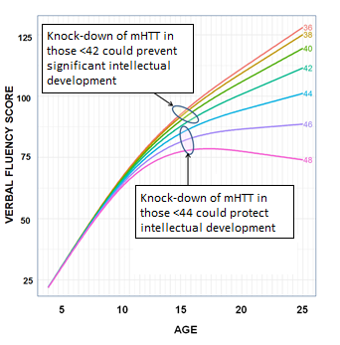
Briefly: Why is it so important to consider brain development up to age 30?
mHTT has a direct effect on potential intelligence.
If the brain continues to mature up through age 30, when is full potential reached?
How do we determine the best timing for gene silencing to prevent disease?
Notes:
A little deeper into why this is an important point to consider:
One of the findings from the Kids-HD and JHD projects is that mHTT has a direct effect on potential intelligence. As you can see here from our Kids-HD data, higher CAG is actually associated with higher intelligence up to a certain point, past the disease threshold. So these folks here at the peak are around 38-42 CAG repeat length, and they are smarter than those with lower and higher CAG repeats. (click)
The big question is:
If the brain continues to mature through age 30, when is full potential reached? (click)
This graph shows one measure of intelligence we used in Kids-HD, Verbal Fluency. You can see varying arcs for several CAG repeat lengths. Here, those with repeats above disease threshold but below 44 have an extended trajectory for developing intelligence. This means their brains have longer development and higher potential intelligence. This is even above the “normal” average! Gene knock down too early for these folks can really impact their intelligence potential.
But these arcs for CAG repeats above 44 show a quicker taper off in intelligence. In this case, early intervention could be better to prevent symptoms and save their intellectual development. (click)

Slide 49

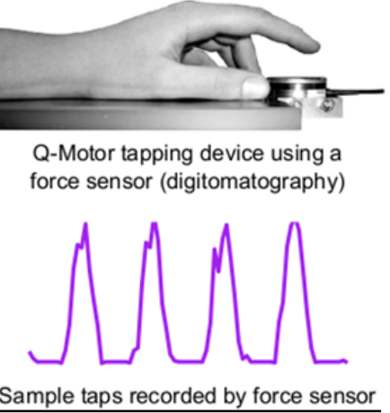
New for ChANGE HD
Computerized neurocognitive assessment
Synchronized MRI scanning protocol
Blood sample for analysis and biobanking
Sensitive fine motor evaluation using Q-Motor and Q-Cog technologies (Ralf Reilmann, Germany)
Collaboration in research on Neurofilament Light (NfL) as a biomarker in pre-manifest HD (Ed Wild, UK)
At-risk young people ages 6 to 30, annual visits
Notes:
So, what’s new in ChANGE HD?
First, we’ll be coming out of the stone age and implementing a whole new, computerized assessment protocol. (click)
We’ll also have a collaborative team of Imaging experts who will oversee a synchronized MRI protocol. (click)
We will still gather blood samples, but this time they will be centrally processed and either shipped for analyses or banked. (click)
We will be collaborating with Ralf Reilmann and his team in Germany to collect even more detailed motor data using their novel Q-Motor and Q-Cog equipment. This equipment uses a forceplate and a series of tasks to evaluate strength, consistency and accuracy of movements. (click)
We will also be collaborating with Ed Wild and his team in the UK on their work with Neurofilament Light, or NfL, which has promise as a biomarker for HD – specifically the potential ability to detect very early brain cell damage. (click)
Finally, as before, we will be extending our age range to 30, and we will ask participants to return each year.
BUT the biggest change is…. (click)

Slide 50
New for ChANGE HD
The University of Iowa – Iowa City, IA
Penn Medicine and the Children's Hospital of Philadelphia – Philadelphia, PA
Columbia University Medical Center – New York, NY
The University of Texas Health Science Center at Houston – Houston, TX
UC Davis Medical Center – Sacramento, CA
Five sites!
Notes:
Five sites! (click)
Yes, Change HD will be a multi-site study, with locations in…
(click)

Slide 51
Participation
Young people under the age of 18 will need to bring at least one parent or guardian along for the visit
Participants are paid for their time and effort
A study day takes about 6-8 hours
All travel arrangements are handled by study staff, and travel-related expenses that cannot be paid in advance will be reimbursed
Eligible participants are at risk for HD. This means they have a parent or grandparent who has been diagnosed with HD.
Older participants who have already had genetic testing are encouraged to keep their status undisclosed to study staff.
Notes:
So, what will participation be like?
Very similar to the Kids-HD and JHD studies:
<18 parent/guardian
Paid
6-8 hours
Travel handled, expenses reimbursed
At risk
Since we will be enrolling folks who may have already done genetic testing, we will be asking them to keep their results from study staff so we can remain blinded to their status.
(click)

Slide 52

Questions?
Comments?
UC Davis Medical Center
4860 Y Street
Suite 3700
Sacramento, CA | 95817
866-514-0858 | 916-891-1233
changehd.org
/ChangeHDresearch
change-hd@uiowa.edu
Enrolling NOW!
@ChANGE_HDstudy
Notes:
I am happy to answer any questions you might have...
I will also be around all day if you think of something later.
If you would like to reach study staff, we are still most accessible through the Kids-HD contacts and social media, but we will be rolling everything over to ChANGE HD very, very soon!

Slide 53
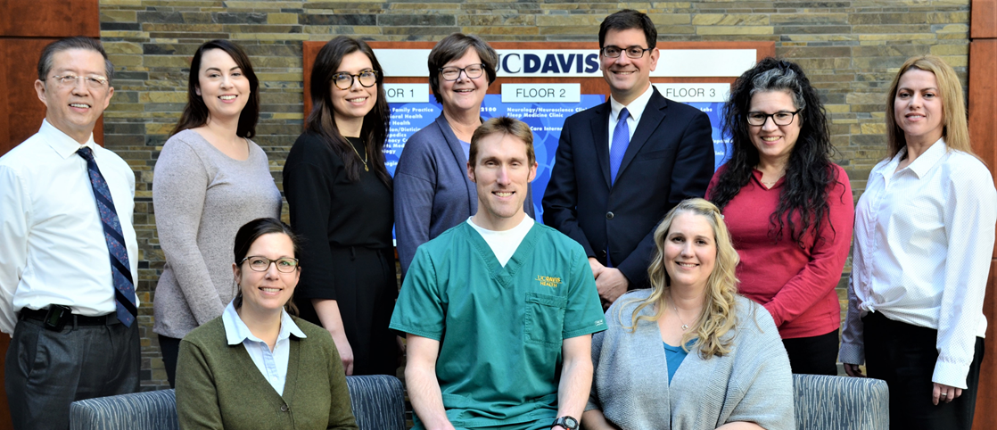
Thank you to HD patients, families and care partners
We are grateful to The Northern CA Chapter of HDSA and to patients and families with Huntington’s disease for your passion and support for care and research for Huntington’s disease
Our work in HD has been inspired and generously supported by the Joseph P. Roberson Foundation, The Charles and Margaret Pue Foundation, HDSA, and HD patients and family members

